Slide 1
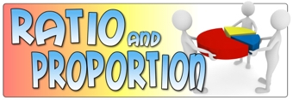

Slide 2
Aim: By the end of the session , you will learn some basics of Ratio and Proportion .

Slide 3

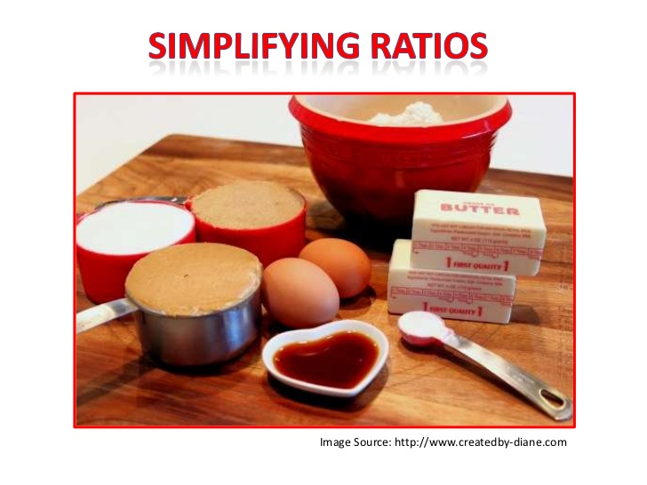
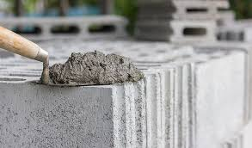
Real life applications

Slide 4
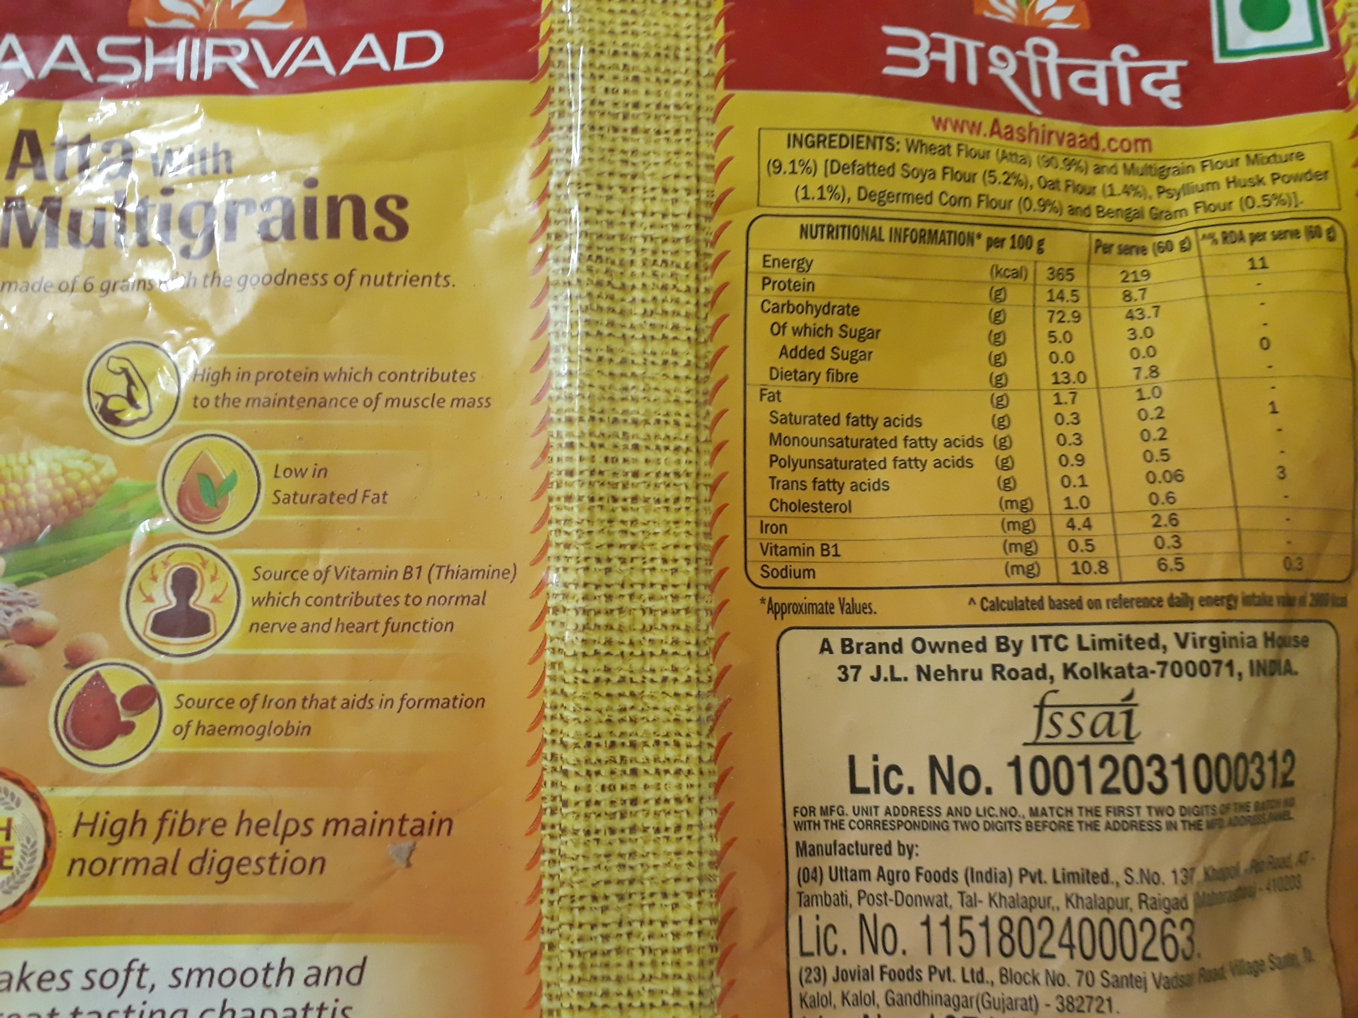
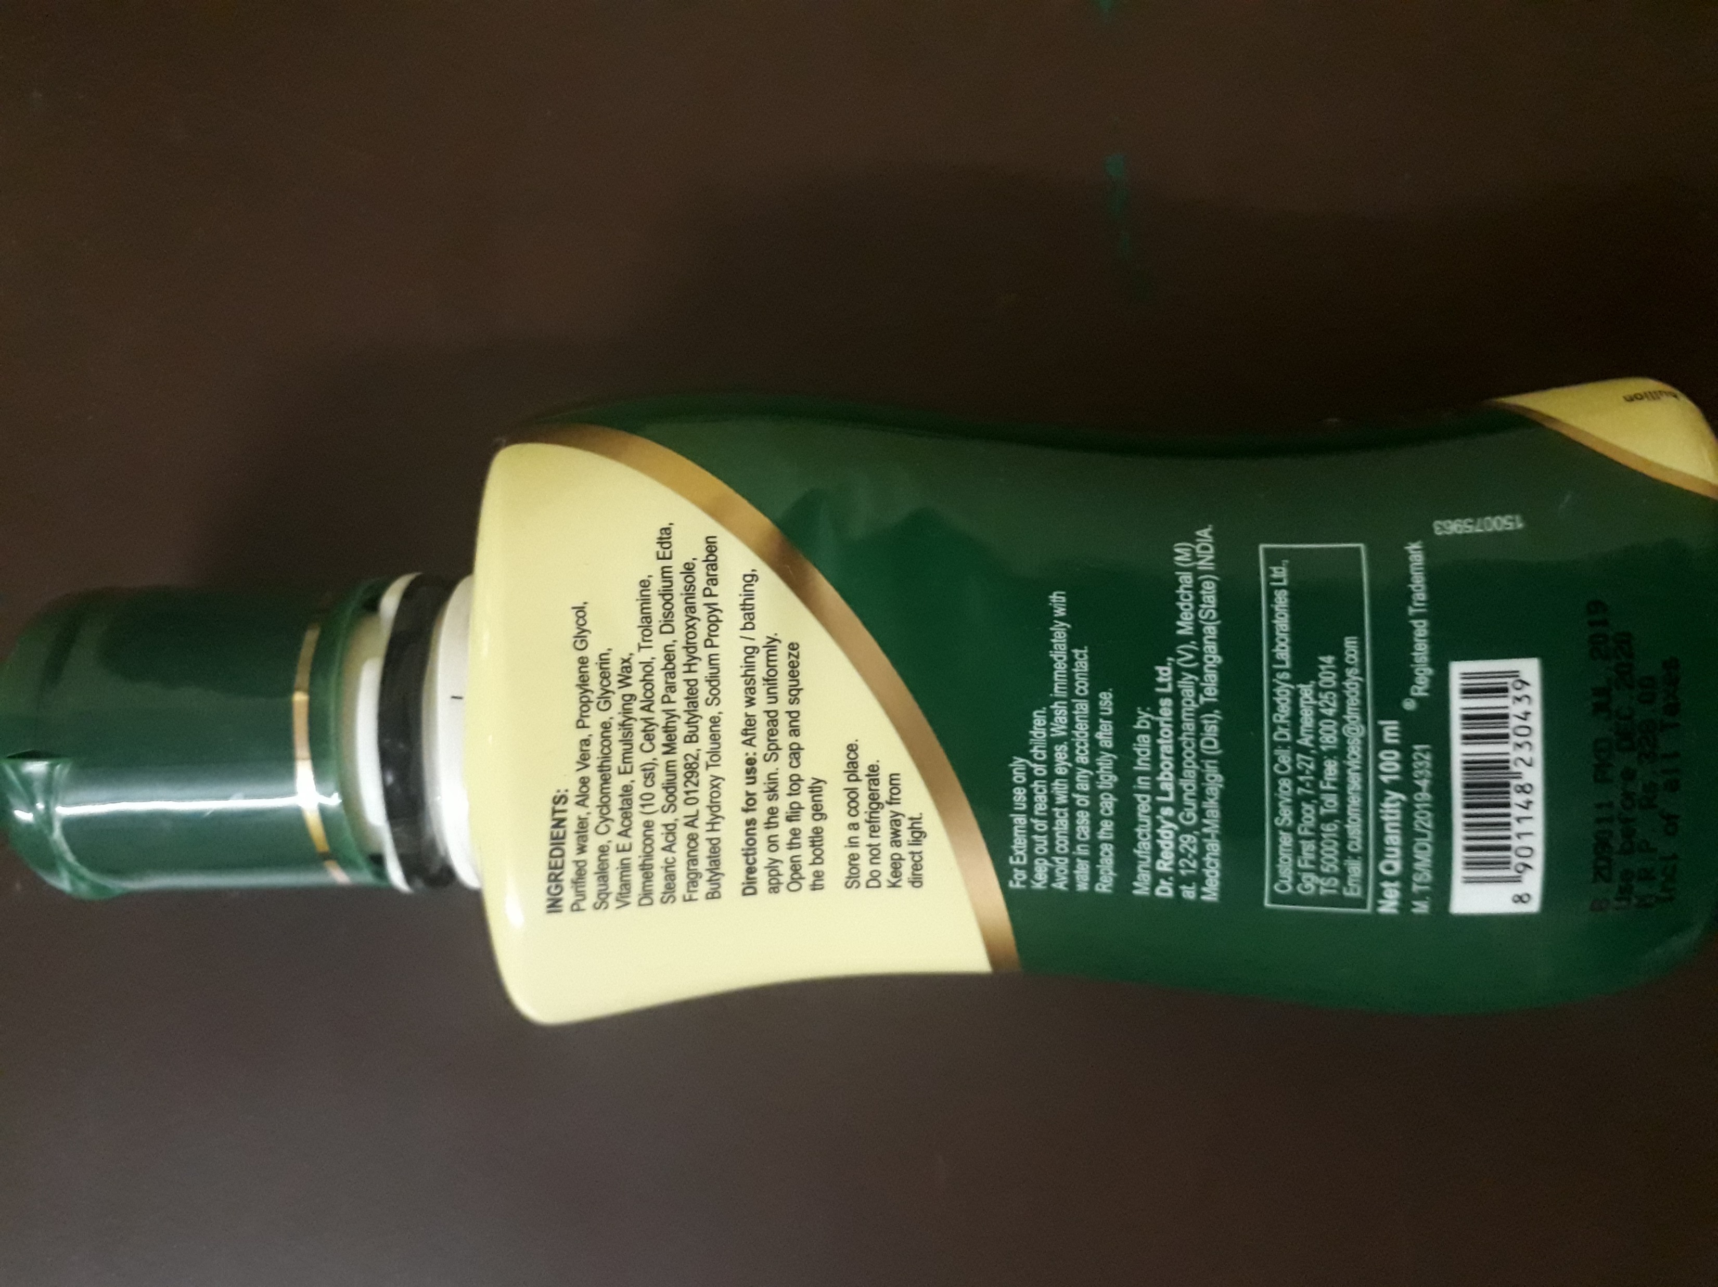

Slide 5

Ratio is a comparisons of two measures
Ratio of red apples to green apples
4:3 can be written as 4/3 or 1.33
We generally use Colon (:) ,fraction form (X/Y) or decimal form for writing ratios

Slide 6
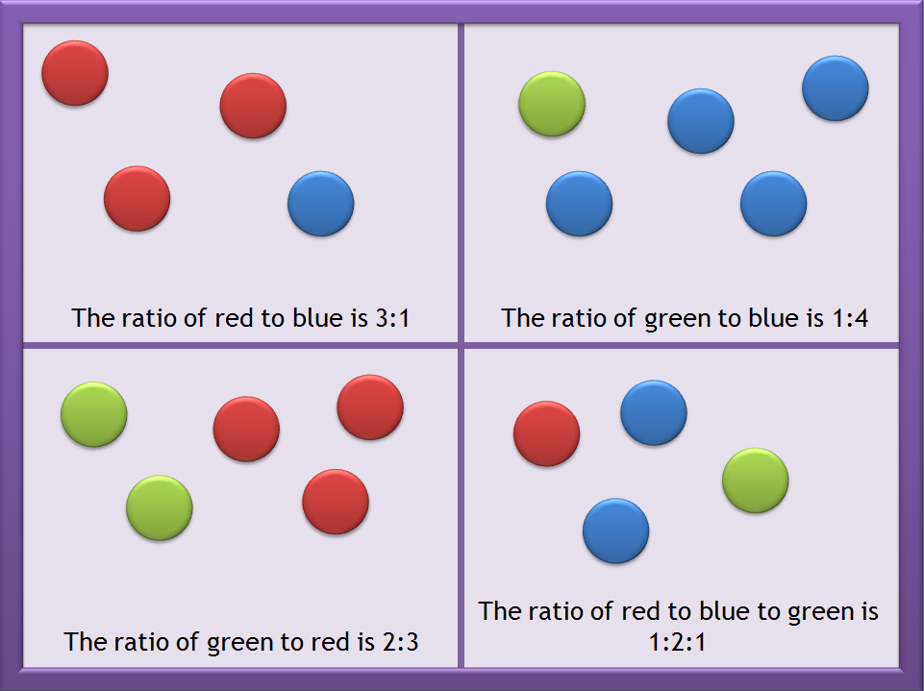
Example:

Slide 7
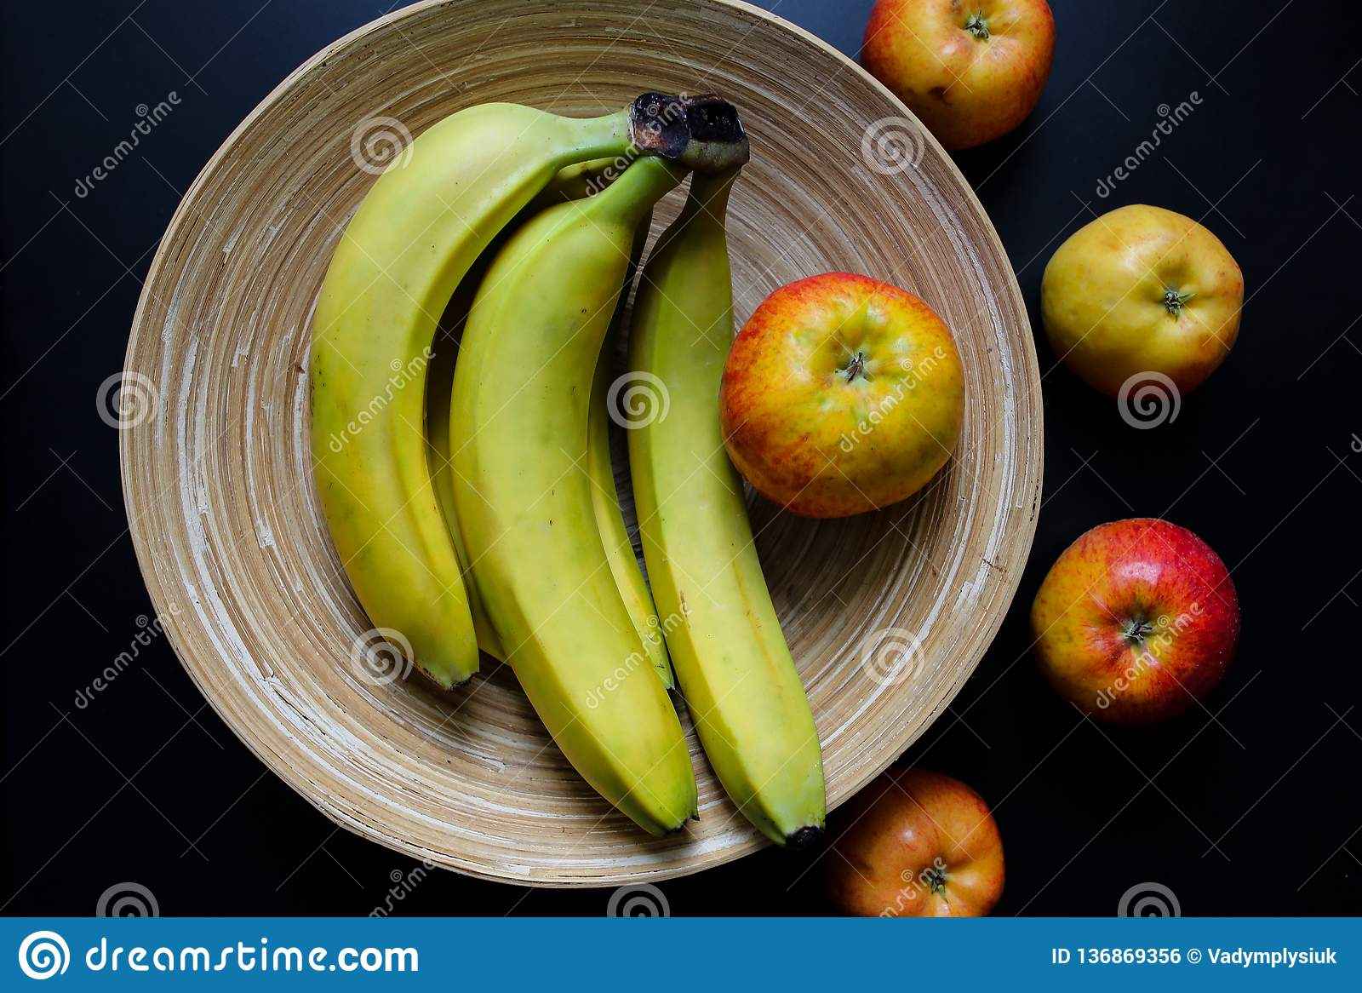
Exercise :

Slide 8
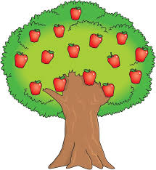
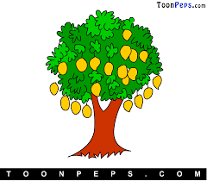
Exercise 2:
Sam planted 9 trees in the orchard. Out of these 5 are mango trees and 4 are apple trees. What is the ratio of mango trees to the total number of trees .
Total number of trees are 9
Ratio= No of mango trees = 5 (or) 5:9
Total No of trees 9

Slide 9
Question 1 :
What is the ratio of 2 feet to 4 yards? Given, 1 yard = 3 feet.
(A) 1 : 2
(B) 1 : 8
(C) 1 : 7
(D)1 : 6
(E) 1 : 5
First convert the entire measurement to either feet or yard
Since 1 yard=3feet
Then 4yards=4x3 =12 feet
Now Ratio of 2feet to 4yards(12feet)
=2/12
=1/6 or 1:6 .

Slide 10
Question 2 :
What is the ratio of 4 feet to 4 meters? Given, 1 meter = 3.28 feet.
(A) 1 : 2.28
(B) 1 : 2.78
(C) 1 : 3.28
(D)1 : 2.88
(E) 1 : 3.68
First convert the entire measurement to either feet or yard
Since 1 meter=3.28 feet
Then 4 meters = 4 x 3.28 =13.12 feet
Now Ratio of 4 feet to 4 meters (13.12 feet)
= 4/13.12
= 1/3.28 (or) 1:3.28

Slide 11
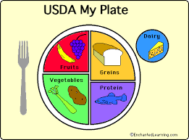
Proportion is an equation that says one ratio is equal to another
a:b: :c:d so we say a,b,c and d are in proportion
Where a & d are called extremes
b & c are called mean terms
Product of means=Product of extremes
Thus a:b: :c:d
(axd)=(bxc)

Slide 12
Question 2 :
If 0.75 ∶ 𝑥 ∷ 5 ∶ 8 then x is equal to:
(A) 1.12
(B) 1.2
(C) 1.25
(D) 1.3
Solution:
0.75 ∶ 𝑥 ∷ 5 ∶ 8
0.75 x 8 = 𝑥 x 5
6=5x
X=1.2 .

Slide 13
Question 3:
Find the unknown value in the proportion
(2x+1 ) : 2 = (x+2): 5
1/8
1/4
-1/8
-1/2
Solution :
5(2x+1) = 2(x+2)
10x+5 = 2x+4
10x-2x = 4-5
8x = -1
x+= - 1/8.

Slide 14
THANK YOU

